Slide 1


ASSESSING
AIR POLLUTION
EFFECTS ON HEALTH
Modeling Associations with Poisson and Negative Binomial GLM
Prof. Prashant Dhamale
Dr. Leena Kulkarni

Slide 2


INTRODUCTION
Numerous studies have consistently demonstrated a substantial correlation between daily pollutant concentration levels and hospital admissions for various respiratory and cardiovascular diseases, underscoring the critical impact of atmospheric pollutants on public health. Population studies and epidemiological research have played pivotal roles in identifying these adverse health effects, providing crucial insights to guide the formulation of practices and legislation aimed at controlling emissions and improving air quality for the well-being of communities.

Slide 3

1
To quantify the association between respiratory disease and air pollution concentrations.
2
To deploy the model which can handle the issue of overdispersion which cannot be accounted by Poisson model.
OBJECTIVES
3
To investigate the effect of serial and cross- correlation of the pollutants on health by GLM–PCA–VAR regression models.

Slide 4
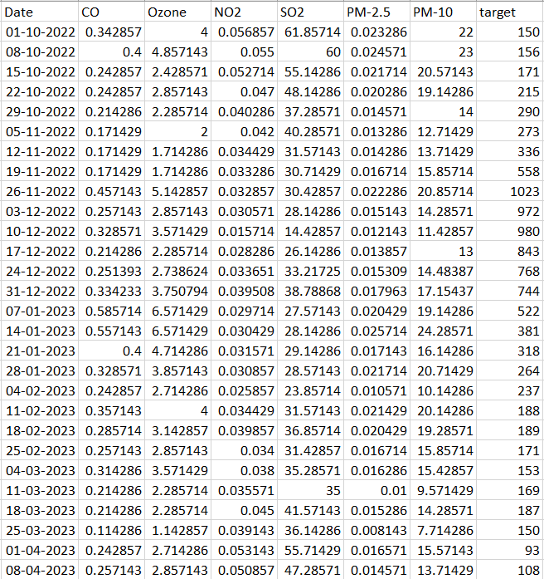

DATA
DESCRIPTION
01
Weekly data count of USA patients collected from Oct 2022 to Jan 2024.
Source: Oklahoma Department of Environment Quality and Centers of disease and control prevention.
02
03
Pollutants taken into consideration are CO, NO2, PM-10, PM-2.5, SO2 and Ozone.
04
Data comprises of 74 data points and 7 variables (1 target variable and 6 independent variables).

Slide 5




DATA CLEANING
Connecting the patient and pollution tables
Using mean imputation to handle missing values (pollutants)
. Connecting the patient and pollution tables
Transformed daily data into weekly format

Slide 6
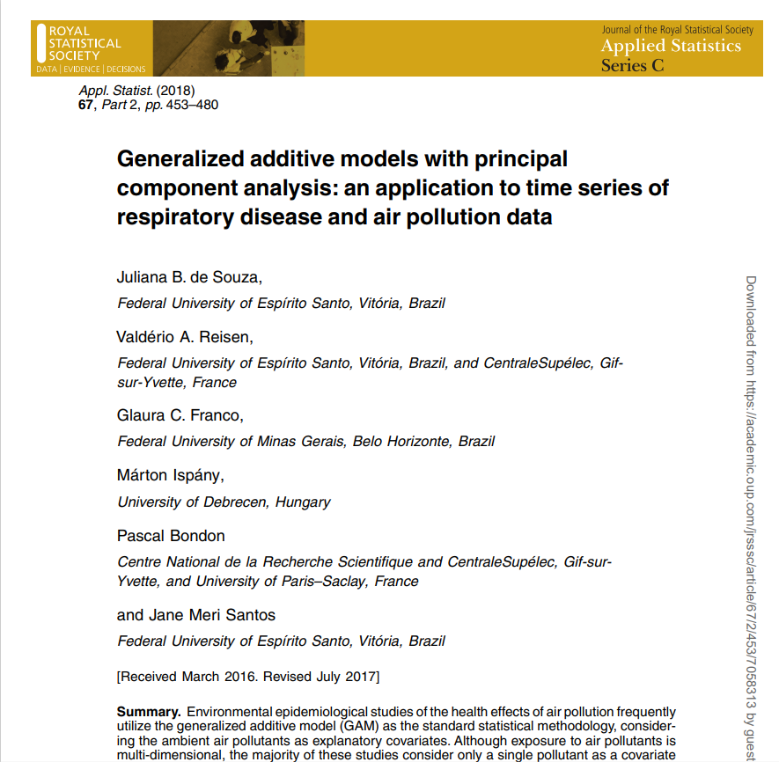
Generalized additive models with principal component analysis: an application to time series of respiratory disease and air pollution data
Juliana B. de Souza
Valderio A. Reisen
Glaura C. Franco
Marton Ispany
Pascal Bondon
Jane Meri Santos

Slide 7

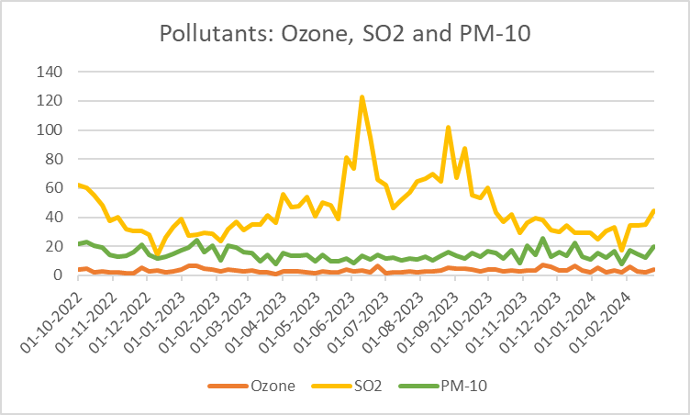
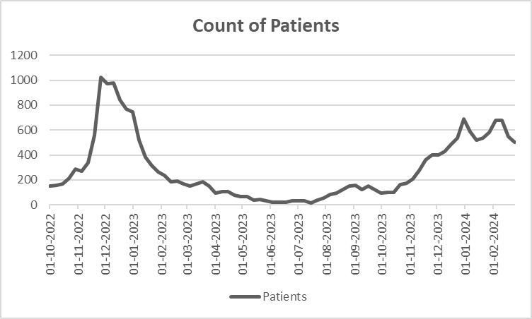
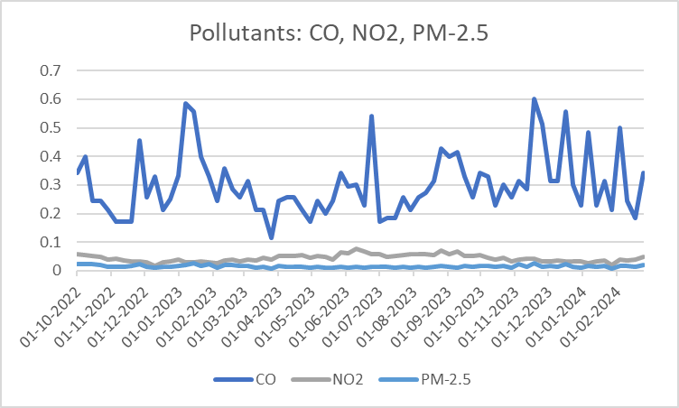
EXPLORATORY DATA ANALYSIS

Slide 8



METHODOLOGY
1
VAR(1) model is used to eliminate autocorrelation in the pollutants.
2
PCA is applied on the residuals of VAR(1) model to remove multicollinearity.
3
Modified PCs were then used as covariates in the GLM.

Slide 9

GENERALIZED LINEAR MODEL
(GLM)

Slide 10
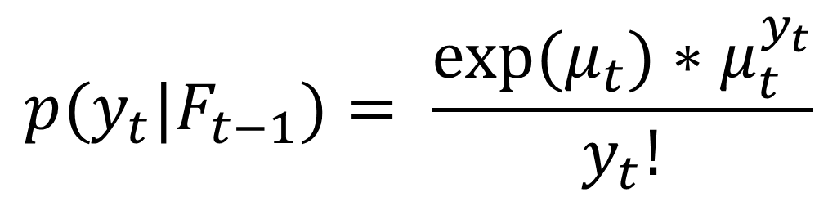
Let {$Y_{t}$} = ${\{Y_{t}\}}_{t∈Z}$ be a count time series i.e. it is compose of non negative integer- values random variables. The conditional Distribution of $Y_{t}$, Given the past $F_{t−1}$which contains the available information up to time t-1, is characterized by the weights p(${y_{t}|F}_{t−1}$):= P(${Y_{t}|F}_{t−1}$) where $y_{t} ∈\{0,1,…\}$. If $Y_{t}$ has a conditional Poisson distribution with mean $μ_{t}$, then
$$p{{(y}_{t}|F}_{t−1})= \frac{{exp⁡(μ}_{t})∗μ_{t}^{y_{t}}}{y_{t}!}$$
Thus, the conditional log likelihood function of the mutually conditionally independent random variables $Y_{1}, … , Y_{n}$ is given by
$$p\left(μ\right)= \sum_{i=1}^{n}{ln⁡\{p{{(Y}_{t};μ_{t}|F}_{t−1})\}} ∝ \sum_{i=1}^{n}{ln⁡\{Y_{t}\ln\left(μ_{t}\right)− μ_{t}\}}$$
$$\ln\left(μ_{t}\right)= \sum_{j=0}^{q}{β_{j}X_{jt}}$$

Slide 11
PRINCIPAL COMPONENT ANALYSIS
(PCA)

Slide 12
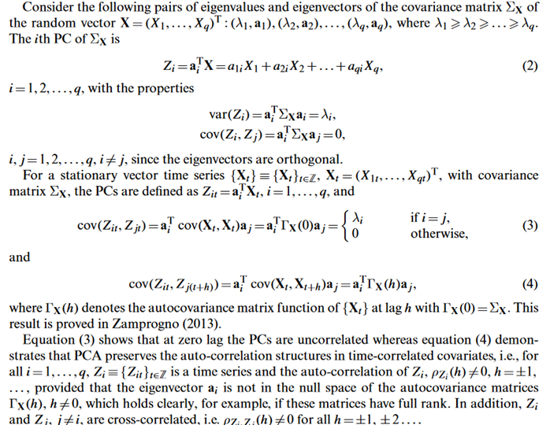
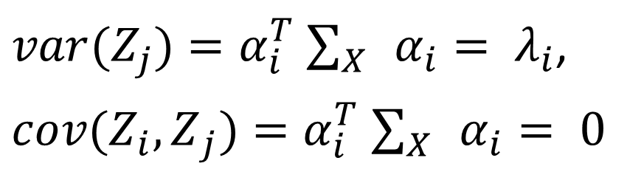
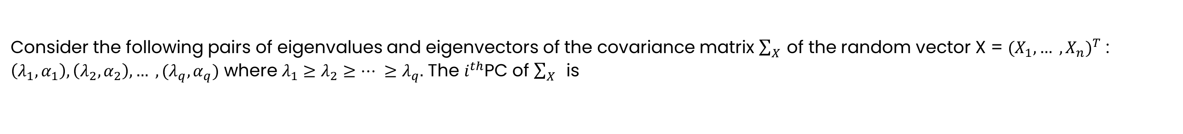
Consider the following pairs of eigenvalues and eigenvectors of the covariance matrix $\sum_{X}{ }$of the random vector X = ${(X_{1}, … , X_{n})}^{T}$ : $\left(λ_{1},α_{1}\right), \left(λ_{2},α_{2}\right), … , (λ_{q},α_{q})$ where $λ_{1}≥λ_{2}≥… ≥λ_{q}.$ The $i^{th}$PC of $\sum_{X}{ }$ is
$$Z_{i}=α_{i}^{T}X=α_{2i}X_{2}+α_{2i}X_{2}+…+α_{qi}X_{q},$$
i = 1,2,3, …, q, with the properties
$var(Z_{j})=α_{i}^{T}$ $\sum_{X}{ }α_{i}= λ_{i}$,
$cov({Z_{i},Z}_{j})=α_{i}^{T}$ $\sum_{X}{ }α_{i}= 0$
i,j = 1,2,…,q, $i≠j$, since the eigen vectors are orthogonal
For a stationary vector time series {$X_{t}\}$ = ${\{X_{t}\}}_{tεZ}$, ${(X_{1t}, … , X_{qt})}^{T}$, with covariance matrix $\sum_{X}{ }$, the PCs are defined as $Z_{i}=α_{i}^{T}X_{t},$ i = 1,…,q, and
and
where $Γ_{X}(h)$ denotes the autocovariance matrix function of $\{X_{t}\}$ at lag h with $Γ_{X}\left(0\right)= \sum_{X}{ .}$
Log likelihood equation:

Slide 13
VECTOR AUTOREGRESSIVE MODEL
(VAR)

Slide 14
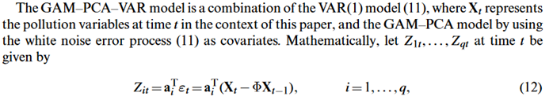
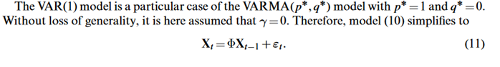
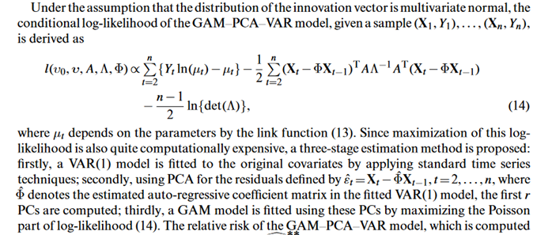
The GLM-PCA-VAR models a combination of the VAR(1) model, where $X_{t}$ represents the pollution variables at time t in the context of this paper, and the GLM-PCA model by using the white noise error process as covariates. Mathematically, let $Z_{1t}, … , Z_{qt}$ at the time t be given by
VAR(1) model is defined as:
Under the assumption that the distribution of the innovation vector is multivariate normal, the conditional lo likelihood of the GLM-PCA-VAR model, given a sample $\left(X_{1},Y_{1}\right), … , (X_{n},Y_{n})$, is derived as
where $μ_{t}$depends in the parameters by the link function.

Slide 15

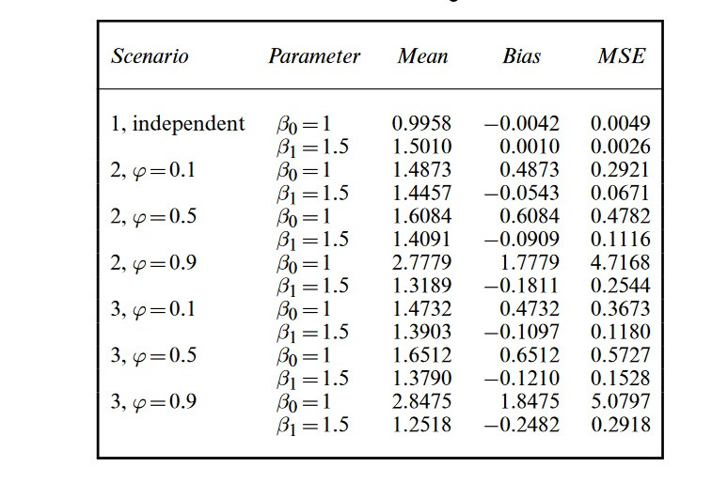
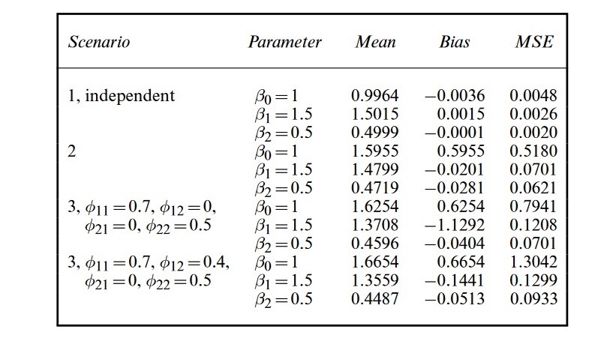

SIMULATION

Slide 16


RESULTS

Slide 17
Augmented Dickey-Fuller Test for Pollutants
Portmanteu test on residuals
Pollutants | Ozone | PM10 | PM2.5 | NO2 | SO2 | CO
p-value | 0.07168 | 0.4163 | 0.3868 | 0.7065 | 0.6656 | 0.05841
LAGS | STATISTIC | DF | P-VALUE
5 | 196.8254 | 180 | 0.18527623
10 | 377.6877 | 360 | 0.25033591
15 | 555.6713 | 540 | 0.31115968
20 | 733.6065 | 720 | 0.35425007
25 | 960.9442 | 900 | 0.07767362
20 | 1161.5273 | 1080 | 0.04215996
Portmanteu test on original data
lags | statistic | df | p-value
1 | 90.82366 | 36 | 1.242108e-06

Slide 18
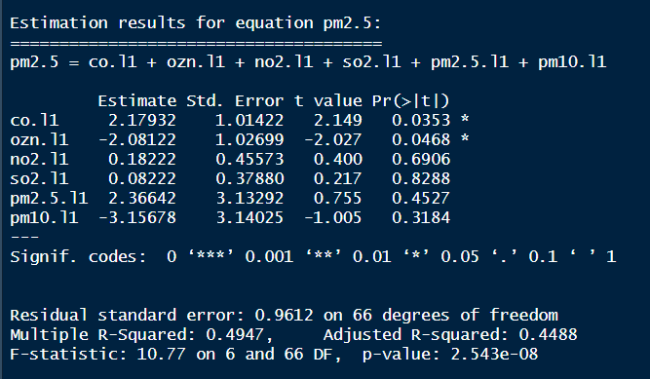
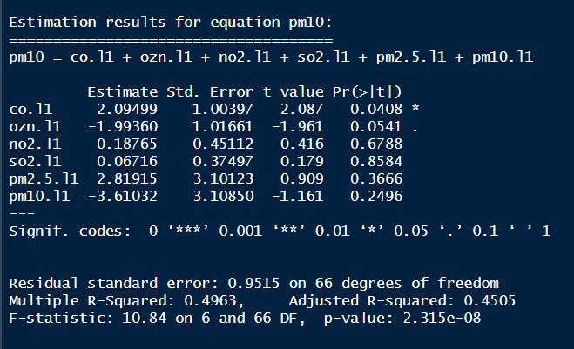
MODEL SUMMARY

Slide 19
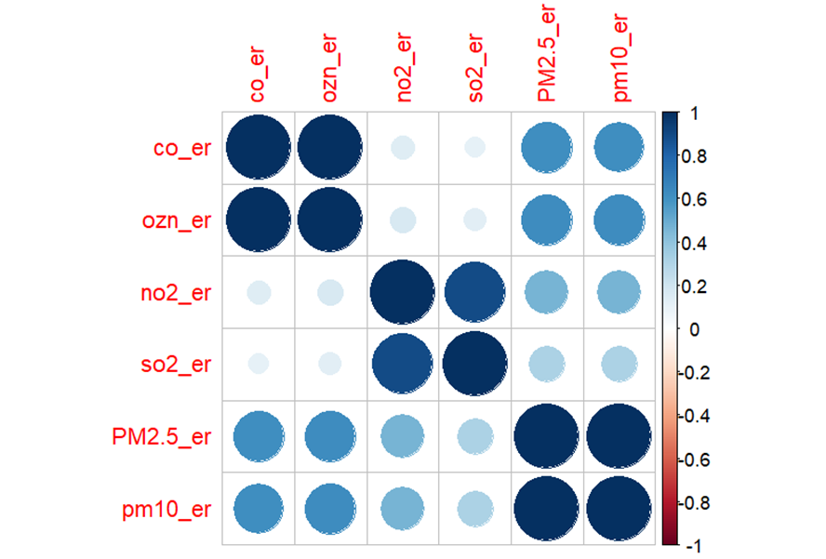
Correlation Matrix of Errors:
Strong positive correlation between:
(a) CO and Ozone
(b) NO2 and SO2
(c) PM-2.5 and PM-10

Slide 20

> IMPORTANCE OF COMPONENTS:
 | PC1 | PC2 | PC3 | PC4 | PC5 | PC6
Standard deviation | 1.8915 | 1.2987 | 0.8031 | 0.29520 | 0.05497 | 0.02249
Proportion of Variance | 0.5963 | 0.2811 | 0.1075 | 0.01452 | 0.00050 | 0.00008
Cumulative Proportion | 0.5963 | 0.8774 | 0.9849 | 0.99941 | 0.99992 | 1.000
> VIF (Model with errors as covariates)
Co_er | ozn_er | no2_er | so2_er | PM2.5_er | pm10_er
186.572746 | 186.618658 | 7.020498 | 5.689976 | 990.380814 | 978.781859
> Condition Number: 7793.4

Slide 21
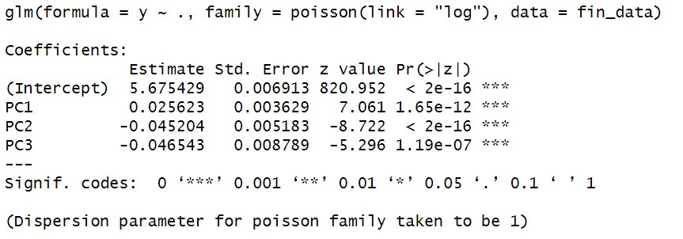

Poisson Generalized
Linear Model
AIC = 16094.01

Slide 22
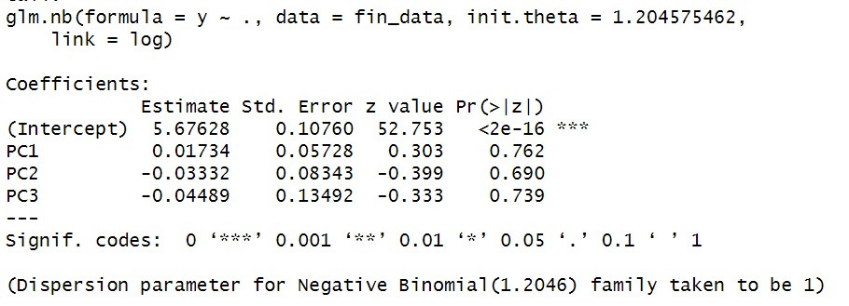
Negative Binomial Generalized
Linear Model
AIC = 970.1699

Slide 23

01
Continued monitoring, regulation, and intervention efforts are crucial for mitigating the health risks associated with exposure to harmful pollutants.
CONCLUSION
Although we did not find any significant relationship between pollutants and health issues, our research made a noteworthy contribution to this field. Further studies may be needed to explore other factors that could be influencing public health outcomes.
02
03
Further research is needed to explore alternative modeling approaches, incorporate additional covariates, and investigate effect modifiers.

Slide 24
LIMITATIONS
Assumption of Linearity
Data Scarcity
Model Comparison
Overdispersion
Poisson and negative binomial GLMs assume a linear relationship between the log of the expected value of the response variable and the predictor variables.
Comparing the performance of Poisson and negative binomial GLMs with GAMs can be challenging, as they represent different modeling approaches with different assumptions and capabilities.
Due to limited no. of observation, it affects the extent to which one can generalize those findings to the larger population.
Poisson GLMs assume that the variance of the response variable is equal to its mean (i.e. equidispersion).

Slide 25
REFERENCES:
Vanhatalo, E. and Kulachi, M. (2016) Impact of autocorrelation on principal components and their use in statistical process control. Qual. Reliab. Engng Int. , 32, 1483 – 1500.
Fine particulate air pollution and hospital admission for cardiovascular and respiratory diseases. Dominici, F. , Peng, R. D. , Bell, M. L. , Pham, L. , McDermott, A. , Zeger, S. L. and Samet, J. M. (2006) J. Am. Med. Ass., 295, 1127–1134.
Time Series: Theory and Methods. New York: Springer. Brockwell, P. J. and Davis, R. A. (1991)
Air pollution and health effects: a study of medical visits among children in Santiago, Chile. Environ. Hlth Perspect., 107, 69–73. Ostro, B. D. , Eskeland, G. S. , Sánchez, J. M. and Feyzioglu, T. (1999)

Slide 26






OUR TEAM
Shardul Gupta
A033
Varsha Jain
A046
Harshal Mandawade A057
Harsh Gidwani
A059
Shreyas Badkar
A060

Slide 27

THANK YOU!

